Slide 1


Computer Concepts 2018
Module 5
Social Media
Copyright © 2019 Cengage. All rights reserved.

Slide 2
Module Contents
Section A: Social Networking
Section B: Content Communities
Section C: Blogs and More
Section D: Online Communication
Section E: Social Media Values

Slide 3
Section A: Objectives (1 of 2)
Use the Social Media Honeycomb to differentiate among various social media
Provide at least two examples of social networking, geosocial networking, content communities, and online communication
List the three elements of a social media profile
Define crowdsourcing and provide three examples

Slide 4
Section A: Objectives (2 of 2)
List and describe four technologies that can be used to locate mobile and stationary devices
Interpret the analytics displayed by a sociogram
Explain how Six Degrees of Separation applies to social networking
Provide examples of the inferences that might be drawn from an adjacency matrix

Slide 5
Section A: Social Networking
The Social Media Mix
Social Networking Evolution
Social Networking Basics
Geosocial Networking
Social Network Analytics

Slide 6
The Social Media Mix (1 of 4)
Social media are online services that facilitate communication and interaction among people who want to share information about their lives, issues, and events using a multimedia mix of text, pictures, video, and audio

Slide 7
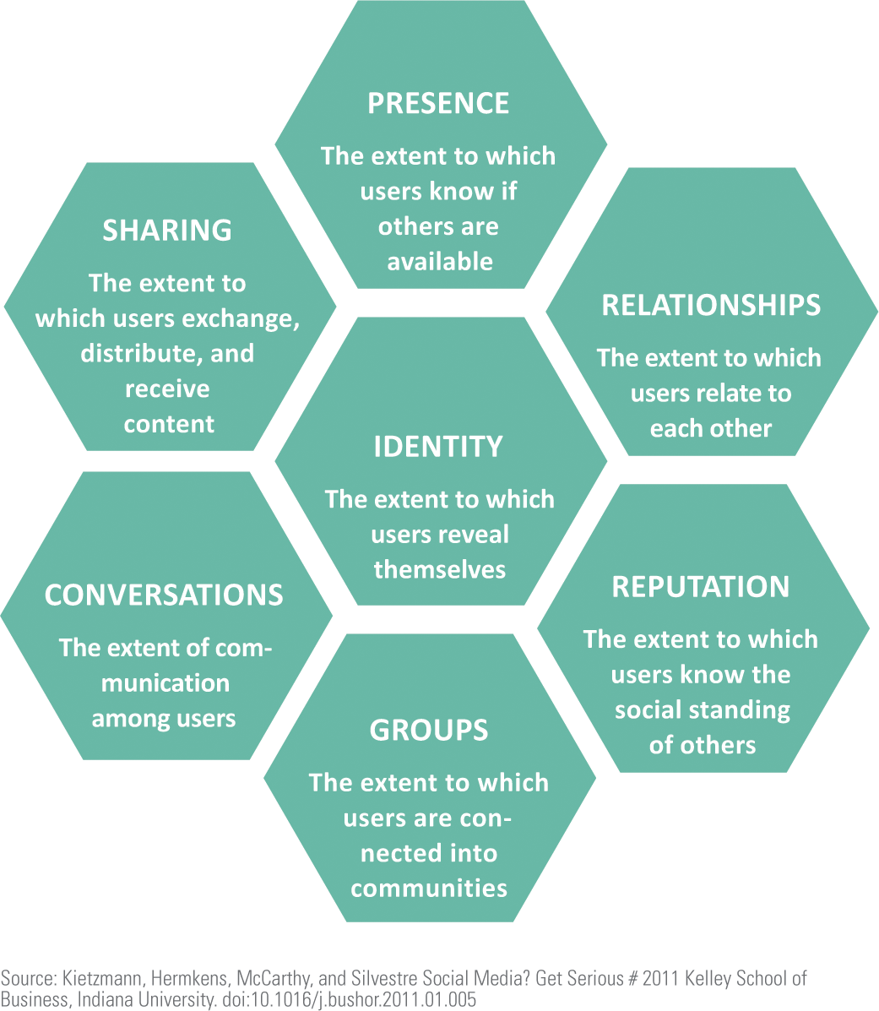
The Social Media Mix (2 of 4)
The Social Media Honeycomb provides a visual model for classifying and comparing various social media services
Each hexagon in the honeycomb represents a social media building block

Slide 8
The Social Media Mix (3 of 4)
In this unit, social media are categorized into four groups:
Social networking
Geosocial networking
Content communities
Online communications

Slide 9
The Social Media Mix (4 of 4)
SOCIAL NETWORKING | GEOSOCIAL NETWORKING | CONTENT COMMUNITIES | ONLINE COMMUNICATION
Good for: Creating an online Presence Connecting with friends and family | Good for: Locating places, people, and events | Good for: Sharing user generated media and topical information Ratings Spreading a message | Good for: One-to-one, real-time communication Asynchronous messaging
Examples: Facebook Google+ Classmates.com Ello LinkedIn Twitter Tumblr | Examples: Yelp Foursquare Yik Yak Nearby Pebblee | Examples: YouTube Flickr Pinterest Instagram Wikipedia StumbleUpon Delicious (bookmarks) Reddit Blogger WordPress | Examples: Email Snapchat Skype Chat Periscope

Slide 10
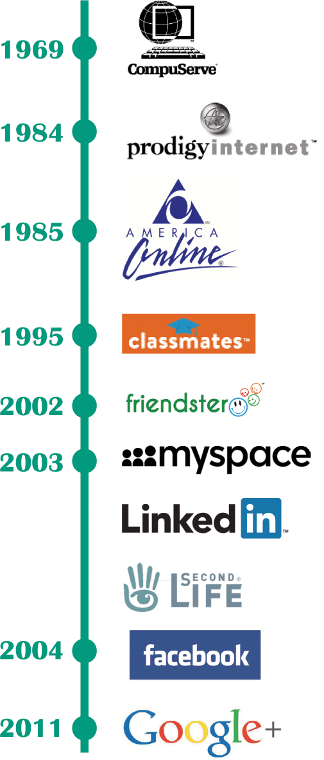
Social Networking Evolution
A social networking service revolves around personal profiles and interconnections among subscribers who want to share information about themselves
Social networking can be traced back to online services, such as CompuServe, Prodigy, and America Online (AOL), which were not part of the Internet

Slide 11
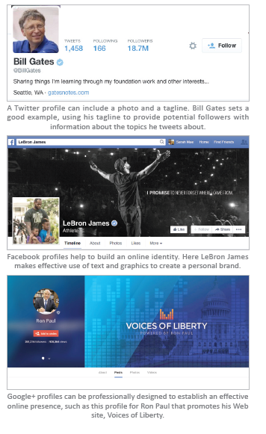
Social Networking Basics (1 of 2)
A person’s presence on a social media service is referred to as an online identity
Each online identity is encapsulated in a profile. A social media profile is the set of information provided to friends, contacts, and the public

Slide 12
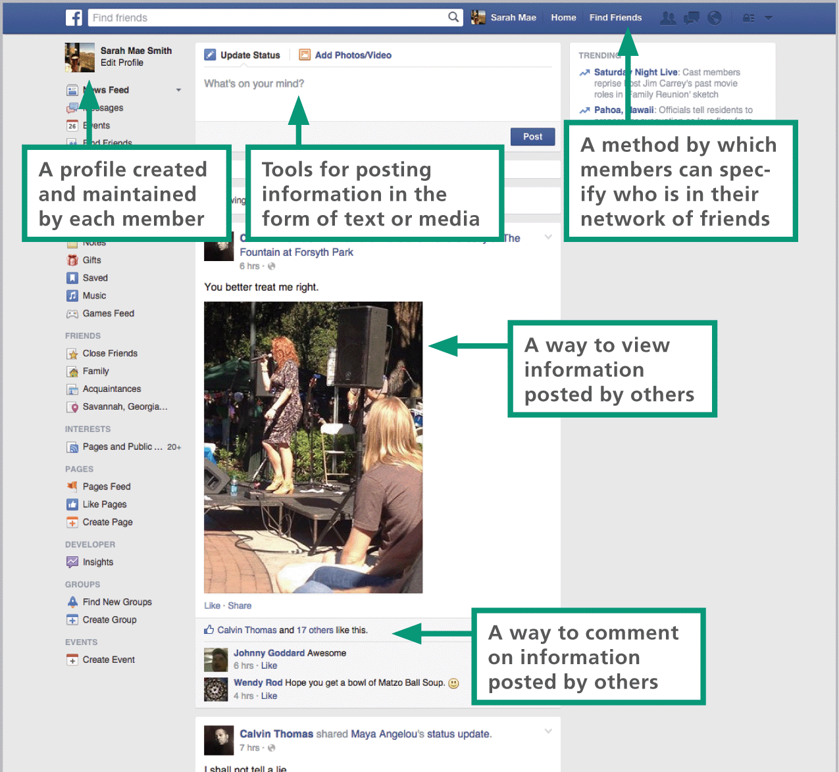
Social Networking Basics (2 of 2)

Slide 13
Geosocial Networking (1 of 5)
Geosocial networking provides a platform for users to carry out interactions based on their current locations
Some of the most popular and well-designed geosocial services include: Yelp, Foursquare, Banjo, and Google Maps
An emerging subset of geosocial networking called social discovery uses geolocation to meet with people who are nearby and have similar interests

Slide 14
Geosocial Networking (2 of 5)
Check in: Registered users open the app or otherwise sign in to indicate they want to interact.
Locate: Using automatic geolocation technology or manually initiated location tracking, the user’s current location is determined.
Search: Depending on the service, users can search for the geotagged places, people, or events that are neraby.
Recommended: Crowdsourced ratings and recommendations are offered.
Map: Maps and directions to selected places, people, or events are provided.

Slide 15
Geosocial Networking (3 of 5)
When individuals contribute computer time, expertise, opinions, or money to a defined project, they are participating in crowdsourcing
Yelp, Amazon, Zappos, and other online merchants provide ratings compiled from user reviews; this is an example of crowdsourcing

Slide 16
Geosocial Networking (4 of 5)
There are four ways that the location of a device can be determined:

Slide 17
Geosocial Networking (5 of 5)
Presenting information about what’s nearby requires places and landmarks to be tagged with their location; geotagging and geocoding provide the necessary geographical information:
Geocoding is the process of determining the coordinates of a specific place, such as the street address or the longitude and latitude of a location
Geotagging is the process of adding location data to photos, Web sites, HTML documents, audio files, blog posts, and text messages

Slide 18
Social Network Analytics (1 of 5)
Social networks are not exclusively online; sociologists use social network diagrams called sociograms to depict connections between people
The circles in these diagrams are referred to as sociogram nodes
The lines connecting nodes are referred to as sociogram edges
Two-way edges exist when two people consider each other to be friends
One-way edges exist when a relationship is not reciprocal, such as a Twitter follower who does not follow back

Slide 19
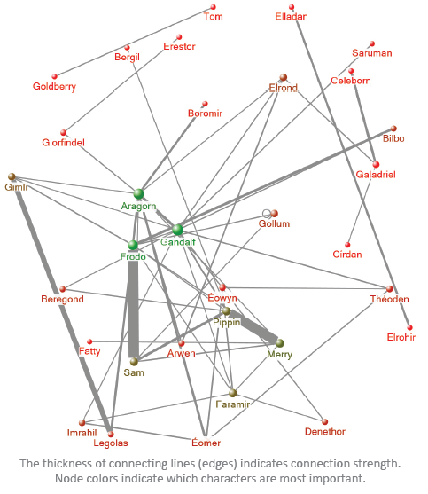
Social Network Analytics (2 of 5)

Slide 20
Social Network Analytics (3 of 5)
Sociograms can get extremely complex, making connections difficult to trace and analyze
An alternative method for depicting social connections is with an adjacency matrix
A binary adjacency matrix is a set of cells containing a 0 if there is no connection between two people and a 1 if there is a connection

Slide 21
Social Network Analytics (4 of 5)
Sociograms and other analytic tools help us to discover and understand the quality and quantity of our personal social networks
One odd phenomenon that was discovered is called the “class size paradox” because it is related to the reason students feel that they are always in larger than average classes

Slide 22
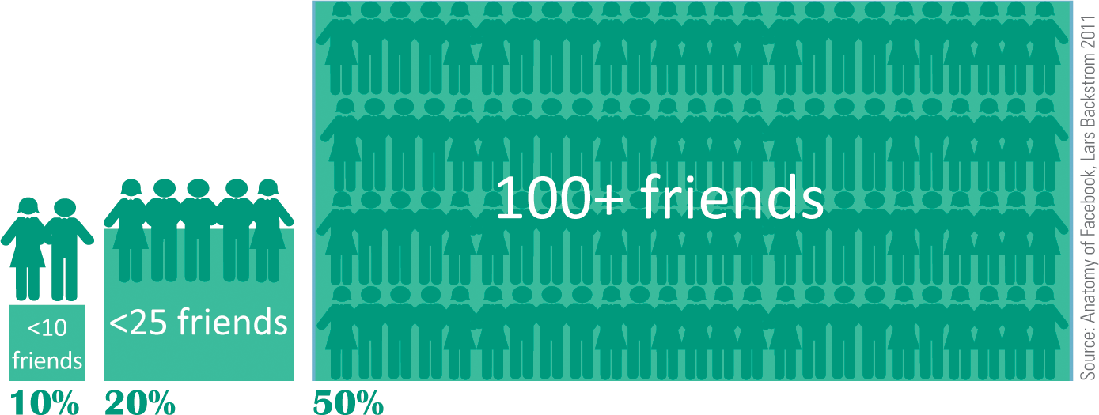
Social Network Analytics (5 of 5)
Here’s how it works: Does it seem like most of your friends have more friends than you have? It turns out that is the case with more than 80% of Facebook users; the explanation is that people tend to choose popular classes and friends, and such popularity does indeed mean that the classes are larger and your friends will have more friends than you have

Slide 23
Section B: Content Communities
Evolution
Media Content Communities
Intellectual Property
Creative Commons

Slide 24
Section B: Objectives (1 of 3)
Use the Social Media Honeycomb to identify the primary characteristics of content communities
Draw a timeline of the emergence of content communities, including significant dates
Explain the concept of viral media
Explain where content is stored and how that may affect privacy

Slide 25
Section B: Objectives (2 of 3)
Describe the financial model for most content communities and how that model may affect the future of these communities
State the difference between formal tagging and informal tagging
List four types of intellectual property and identify which two are typically encountered in content communities

Slide 26
Section B: Objectives (3 of 3)
List the six rights that are exclusively exercised by copyright holders
List the five rights that can be granted under a Creative Commons license
List the four factors that characterize fair use
State the difference between a derivative work and a transformative work

Slide 27
Evolution (1 of 3)
Many social media sites, such as Wikipedia, YouTube, and Flick, were designed as repositories for user-generated content
These social media sites are sometimes called content communities
These communities may focus on text-based information, or their focus may be on other media, such as photos, music, or video

Slide 28
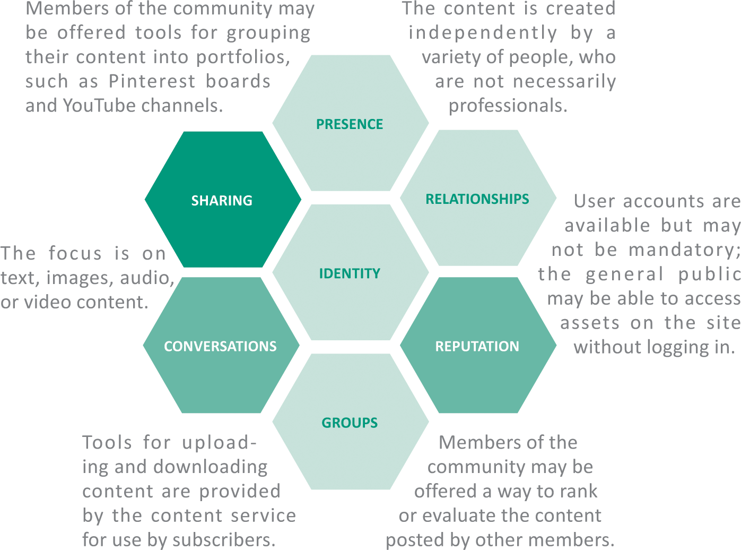
Evolution (2 of 3)
Content communities typically have these characteristics:

Slide 29
Evolution (3 of 3)
The bulletin board systems (BBSs) of the 1970s contained user-generated content and could be considered forerunners of today’s content communities and social networks
In 2001 a text-based collaborative called Wikipedia was launched and a community of contributors quickly formed around it
Video content communities launched with the founding of YouTube in 2005; that same year was the first instance of an online video going viral
In the context of social media, viral refers to media elements that quickly infiltrate popular culture via social media

Slide 30
Media Content Communities (1 of 2)
Media content communities are so popular that most people with an Internet connection have logged in to take a look at videos from YouTube and images from Flickr
Although many content communities allow open access to media, most require registration before files can be uploaded
Content communities offer simple tools for uploading media files from a computer, and most offer apps that handle uploads from mobile devices

Slide 31
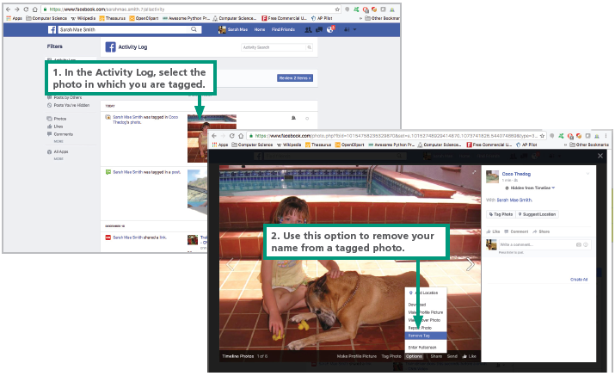
Media Content Communities (2 of 2)
A metadata tag is simply a keyword that describes information, such as the content of a media element
Formal tagging methods add information to a tag according to a set of tagging standards

Slide 32
Intellectual Property (1 of 2)
All of the creations that materialize from the mind or intellect are considered intellectual property
Inventors, artists, writers, and other creative individuals are the owners of their intellectual property
There are four categories of intellectual property:
Patents
Trademarks
Copyrights
Trade secrets
A trademark is any word, name, symbol, or design used in commerce to identify and distinguish the goods of one company from those of another

Slide 33
Intellectual Property (2 of 2)
Copyright is a form of legal protection that grants the author of an original work an exclusive right to copy, distribute, sell, and modify that work
Public domain refers to the status of works with expired copyrights or whose creators have forfeited their copyright; the works of Shakespeare are in the public domain

Slide 34
Creative Commons (1 of 5)
A Creative Commons license is based on five rights that copyright holders can grant or deny to others
ATTRIBUTION. When the work is used, the copyright holder must be given credit for the work in a citation or another appropriate manner.
SHARE ALIKE. New works based on the original must be distributed under the same license as the original work.
NO DERIVATIVES. The work must not be changed when it is redistributed or shared.
PUBLIC DOMAIN. All rights are granted for reuse or the work has been placed in the public domain.
NONCOMMERCIAL. The work may not be used for commercial purposes.

Slide 35
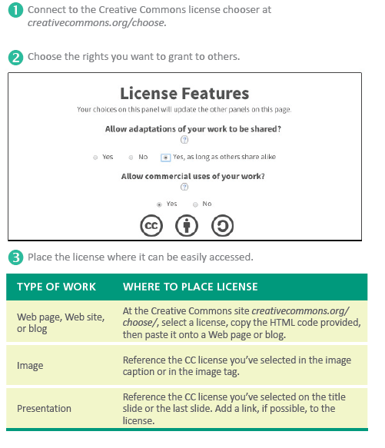
Creative Commons (2 of 5)
Whereas copyright is designed to limit the use of a work, copyleft is designed to make a work freely available for distribution and modification under the condition that all derivative works use the same license

Slide 36
Creative Commons (3 of 5)
Fair use allows for the limited use of copyrighted material without obtaining permission from the copyright material
United States copyright regulations include four factors that characterize fair use:

Slide 37
Creative Commons (4 of 5)
The purpose and character of the use. The use of copyrighted mate­rials without permission is more likely to be "fair" when the materials are transformed and used for a purpose different from that of the original work.
The nature of the copyrighted work. Guidelines for fair use of photos may differ from guidelines for music, videos, or written works.
The amount of the copyrighted work that is used. Quoting a paragraph from a book is more likely to be fair use than reproducing an entire chapter.
The effect on the value of the copyrighted work. Uses that deprive the copyright holder of income are not generally considered fair use.

Slide 38
Creative Commons (5 of 5)
A derivative work modifies a copyrighted work but does not substantially change its content or purpose; translations and adaptations are examples of derivative work
A transformative work repackages a copyrighted work to add new meaning or produce a work that is used for a purpose different from the original work; parodies are considered transformative

Slide 39
Section C: Blogs and More
Blogs
Microblogs
Wikis

Slide 40
Section C: Objectives (1 of 3)
Identify the six major elements of a blog page
Describe the purpose of RSS readers and blog aggregators
Discuss why blogs are considered a disruptive technology
List five questions that help to evaluate the quality of information presented in a blog

Slide 41
Section C: Objectives (2 of 3)
Give examples of six ways in which Twitter has expanded its focus to go beyond personal status updates
Identify the major elements of a Twitter page
Describe the characteristics of a wiki
Explain how Wikipedia articles are written and edited

Slide 42
Section C: Objectives (3 of 3)
Explain the meaning of NPOV, NOR, and V in the context of Wikipedia
Identify the elements of a Wikipedia article
Identify the purpose of each Wikipedia tab

Slide 43
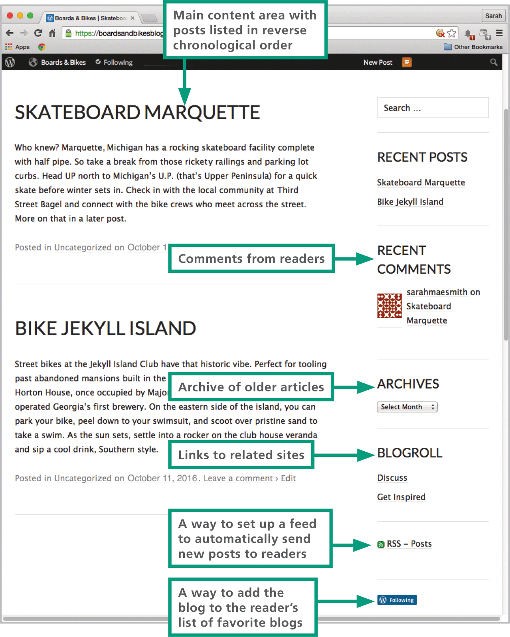
Blogs (1 of 4)
A blog (short for Web log) is a sequence of informational articles posted in reverse chronological order and displayed on a scrollable Web page.
Blogs are generally maintained by a person, a company, or an organization

Slide 44
Blogs (2 of 4)
Blogger and WordPress are the most popular blogging platforms
You can use an RSS reader or blog aggregator to set up a “feed” that monitors your favorite blogs, collects the latest posts, and displays them
The blogosphere—all the blogs and their interconnections—is influential; blogs and other Internet-based news outlets have the potential to reach mass audience

Slide 45
Blogs (3 of 4)
Professional journalists and the media companies they represent are guided by a code of ethics that encourages seeking truth, reporting it, minimizing harm, resisting outside influences, and maintaining accountability
Who is the blogger? Look for information about the blogger’s expertise at sites other than the blog.
What are the blog’s readership and Alexa rating? Popular blogs tend to be more reliable because they are subject to scrutiny by many readers.

Slide 46
Blogs (4 of 4)
Are comments substantive and supportive? Blogs that generate negative comments and corrections may not contain accurate information.
How extensive is the blog’s archive? Well-established blogs may remain active for many years, so look at the blog’s track record and also make sure it contains recent posts.

Slide 47
Microblogs (1 of 2)
Twitter was modeled as a Web-based version of the text messaging services offered on mobile phones; it is an example of a microblogging service
A microblogging service is essentially a short blog post
Twitter messages, called tweets, are limited to 140 characters

Slide 48
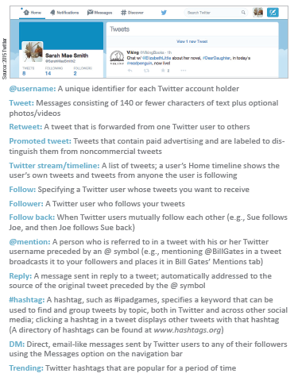
Microblogs (2 of 2)
Twitter has a vocabulary all its own, and some of its terminology has spilled over to other social media

Slide 49
Wikis (1 of 5)
A wiki is a collaborative Web application that provides tools that enable contributors to post, read, and modify content
Participants are encouraged to register with the Wikipedia community and become “Wikipedians”
As of 2016, more than 125,000 participants were regular contributors

Slide 50
Wikis (2 of 5)
(NPOV) Neutral point of view: Content for Wikipedia articles should be phrased and presented in neutral language and with unbiased intent.
(NOR) No original research: Articles should be based on existing recognized knowledge. Personal views and original research are not appropriate.
(V) Verifiability: Readers must be able to verify all content against reliable external sources based on citations included within the text and listed at the conclusion.

Slide 51
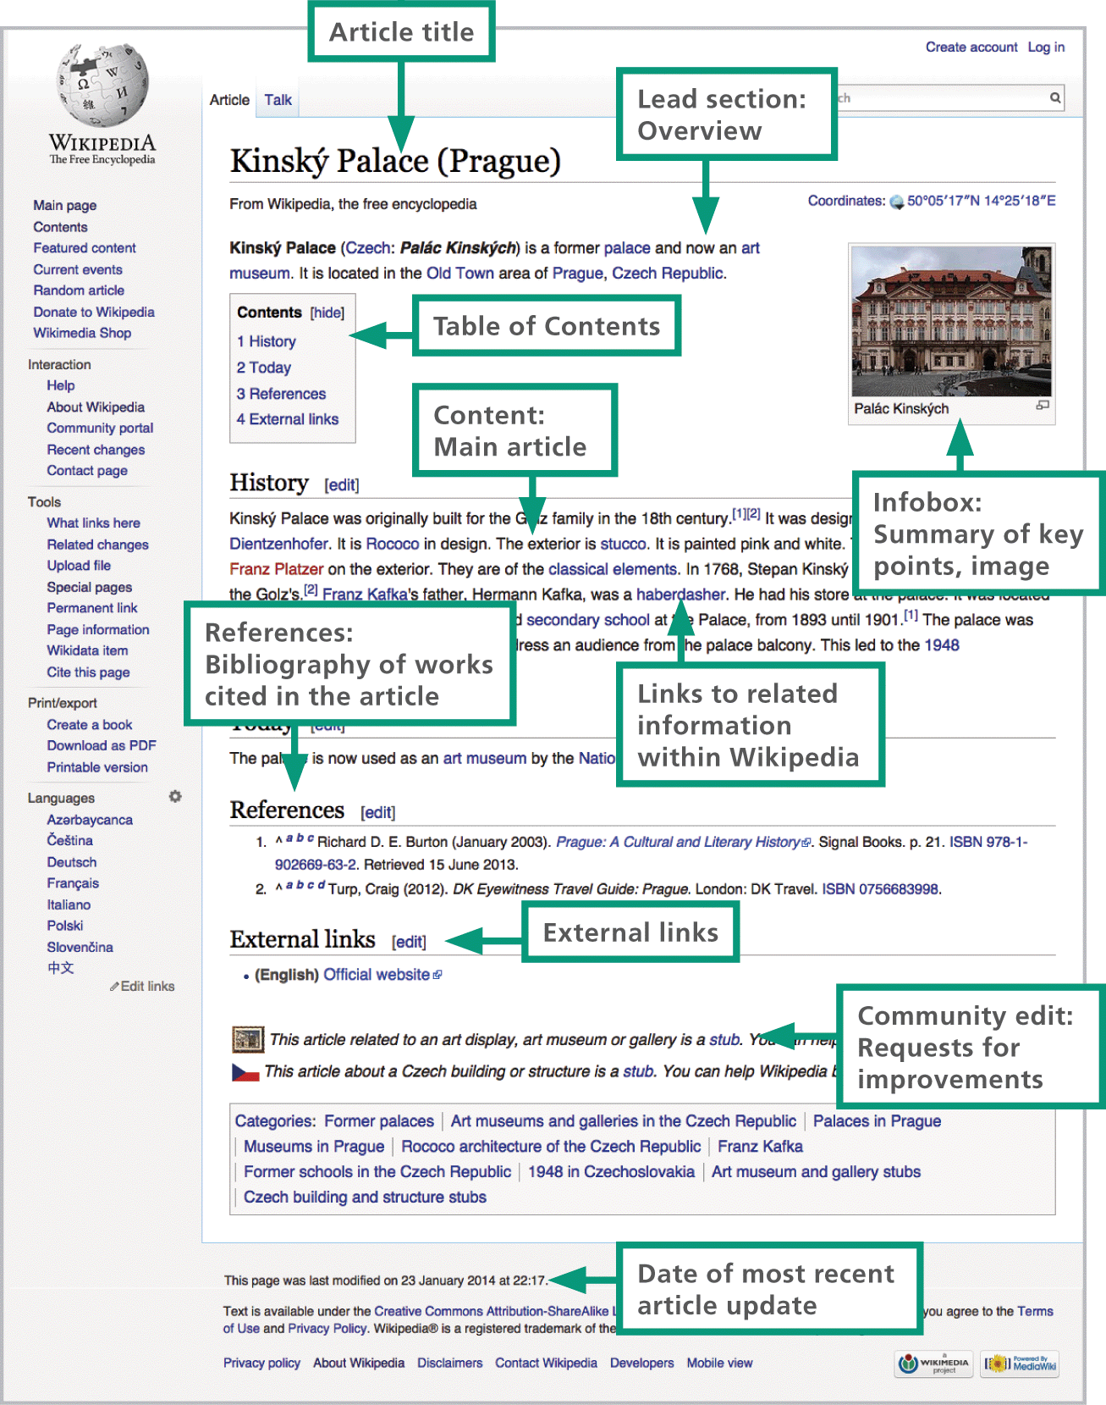
Wikis (3 of 5)

Slide 52
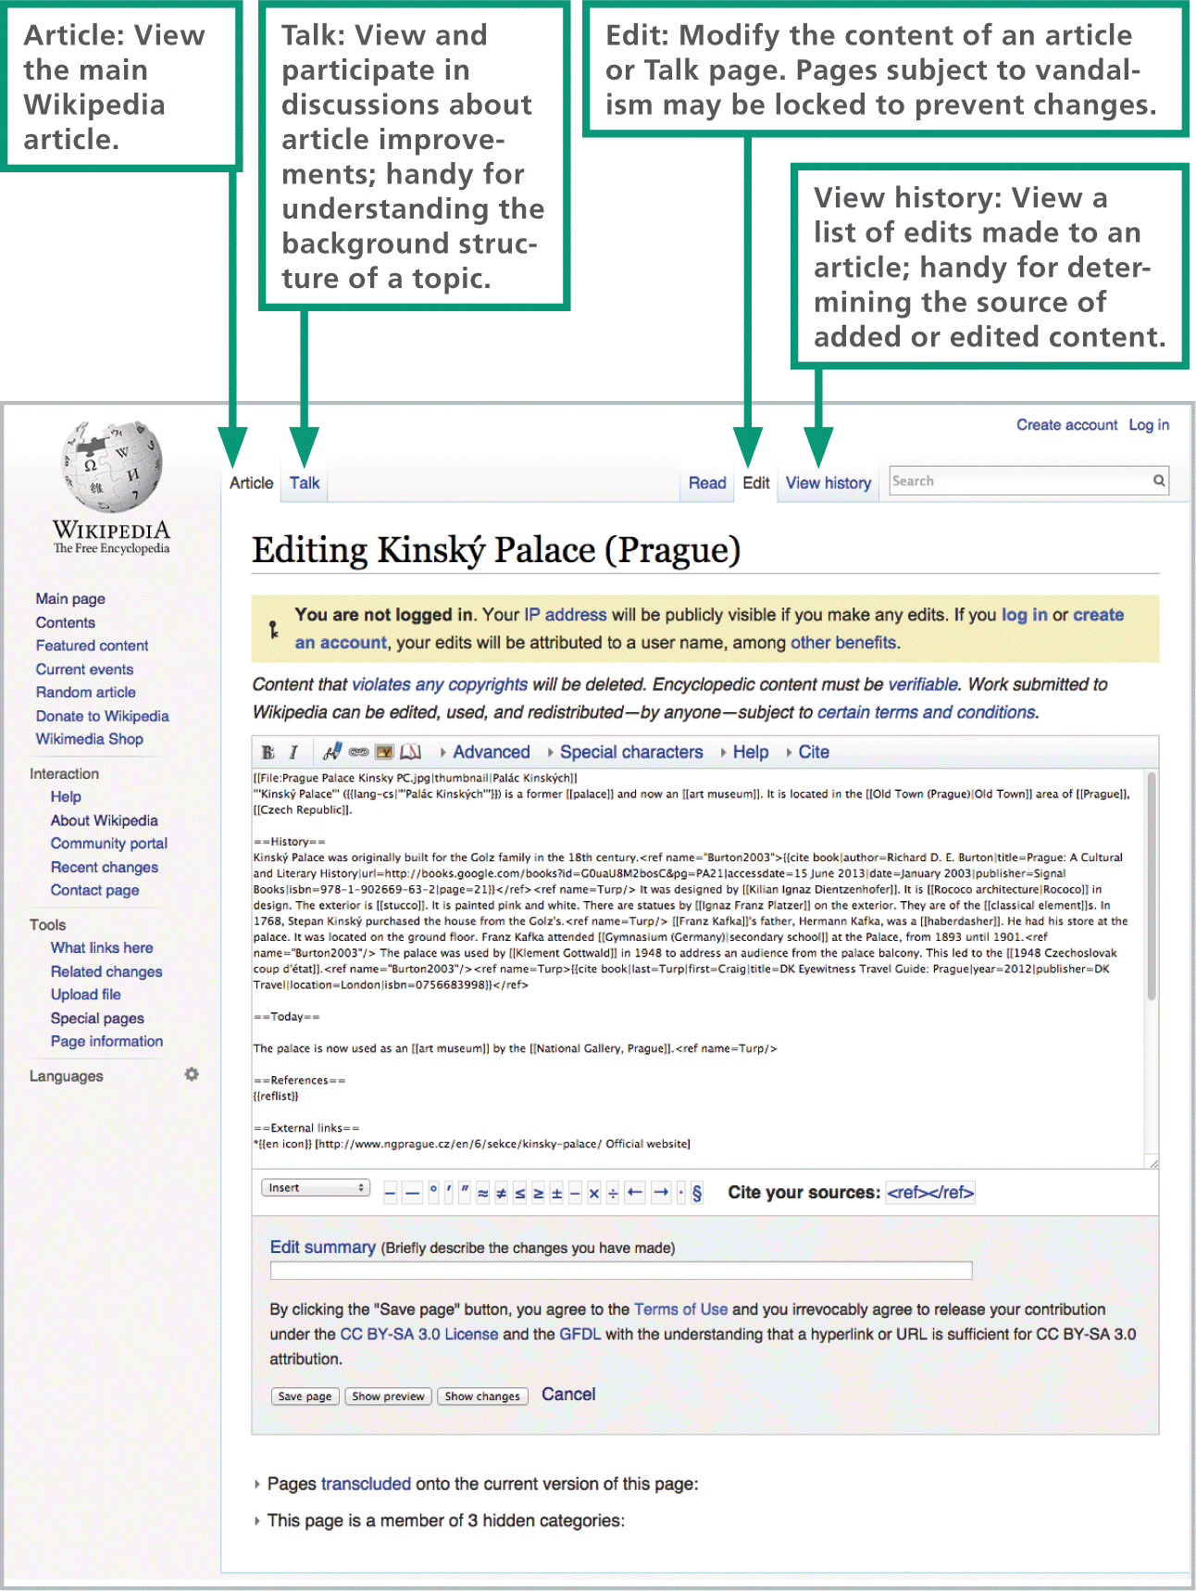
Wikis (4 of 5)

Slide 53
Wikis (5 of 5)
Do not quote Wikipedia directly; do not list Wikipedia articles in bibliographies; work with original sources.
Cross-check before using facts from Wikipedia articles.
Follow links in citations or use Google to locate original sources before including information in research papers.
Never “lift” citations from the references section of a Wikipedia article; use citations only if you have examined the source document.
Be sure to use sources beyond Wikipedia to research topics in sufficient depth.
Before submitting papers, articles, and other academic work, check the sourcing guidelines provided by instructors or editors who will review your work.

Slide 54
Section D: Online Communication
Communication Matrix
Email
Online Chat
Voice and Video over IP

Slide 55
Section D: Objectives (1 of 3)
Classify communications technologies as synchronous, asynchronous, public, or private
List the pros and cons of Webmail and local mail
Explain how the term store-and-forward relates to email

Slide 56
Section D: Objectives (2 of 3)
Differentiate between IMAP and POP
List four steps that help to reduce the security risk of accessing email on a public computer
Explain the circumstances under which a person might want to forward email between a Webmail account and a local account

Slide 57
Section D: Objectives (3 of 3)
Describe the evolution of online chat
List four services that use VoIP technologies
Explain the controversy pertaining to Snapchat and its significance for using social media services

Slide 58
Communication Matrix (1 of 4)
The Internet offers many tools for communicating and collaborating; more are appearing every day
Public Asynchronous
Blogs
Microblogs (Twitter)
Forums and discussion groups
Public social media posts
Public Synchronous
Chat rooms
Live streaming video

Slide 59
Communication Matrix (2 of 4)
Private Asynchronous
Email
Text messaging service (SMS)
Multimedia messaging service (MMS)
Private social media posts
Snapchat
Private Synchronous
Voice over IP (Skype)
Videoconferencing (WebEx)
Instant messaging (ICQ, AIM)

Slide 60
Communication Matrix (3 of 4)
Synchronous communication – interchanges happen in real time while all parties are online; these communications have the advantage of immediacy
Asynchronous communication – messages are held until the recipient is ready to view them; it offers convenience because information can be gathered whenever you want it

Slide 61
Communication Matrix (4 of 4)
Public communications – can be accessed by individuals unknown to the person who created a message; the word posting is associated with this type of communication because it is similar to posting a billboard, sign, or poster
Private communications – communications for which you specify one or more recipients; text messaging is a popular type of private communication

Slide 62
Email (1 of 8)
The term email can refer to a single message or to the entire system of computers and software that transmits, receives, and stores email messages
An email message is an electronic document transmitted over a computer network
The computers and software that provide email services form an email system
At the heart of a typical email system is an email server—a computer that essentially acts as a central post office for a group of people

Slide 63
Email (2 of 8)
Email messages have a standard format that consists of a message header and the message body; the message header contains the sender and recipient addresses, date, and subject line

Slide 64
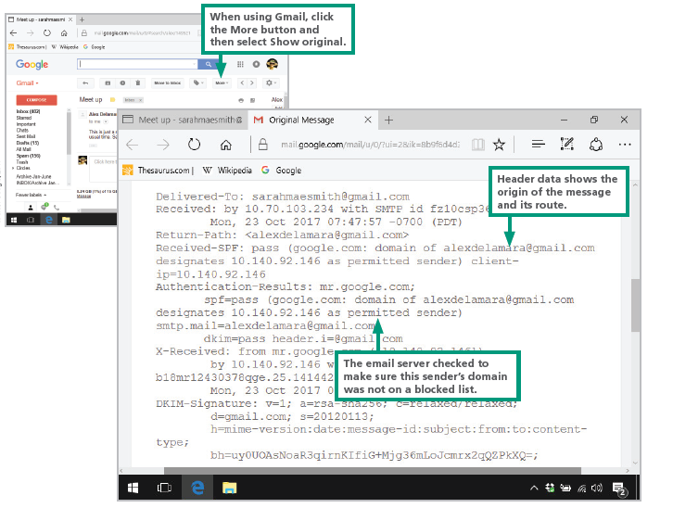
Email (3 of 8)

Slide 65
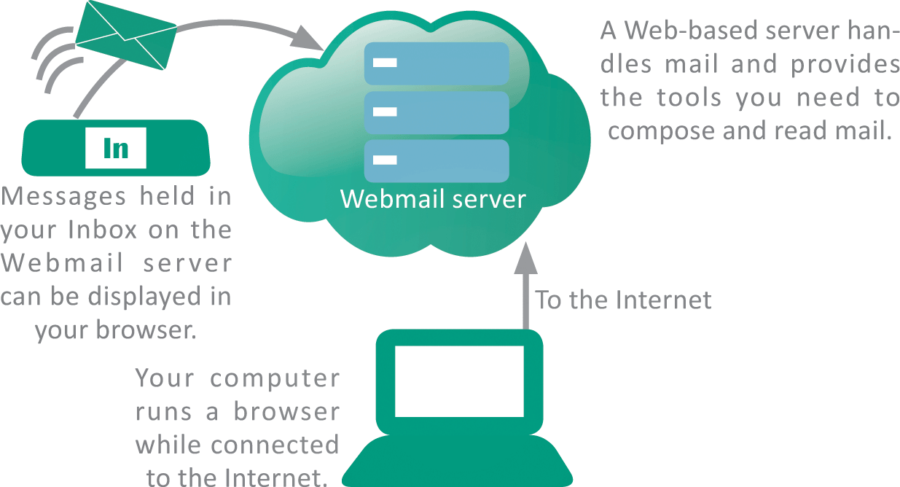
Email (4 of 8)
Webmail is typically a free service accessed using a browser

Slide 66
Email (5 of 8)
Pros and Cons of Webmail:
Affordable – most Webmail is free; you can easily establish additional accounts
Access from any devices – it can be accessed from any device that has a browser
Access anywhere – it’s ideal for people who travel because messages can be accessed from any computer connected to the Internet
Security risks – your email messages are stored on Web servers that can be hacked into
Advertising – free Webmail is supported by advertising, so expect to see ads

Slide 67
Email (6 of 8)
When you use local email, an Internet-based email server stores your incoming messages until you launch your email client and get your mail
This telecommunications technique is sometimes referred to as store-and-forward
The protocols POP3 (Post Office Protocol version 3) and IMAP (Internet Message Access Protocol) can be used to manage incoming mail
SMTP (Simple Mail Transfer Protocol) handles outgoing mail

Slide 68
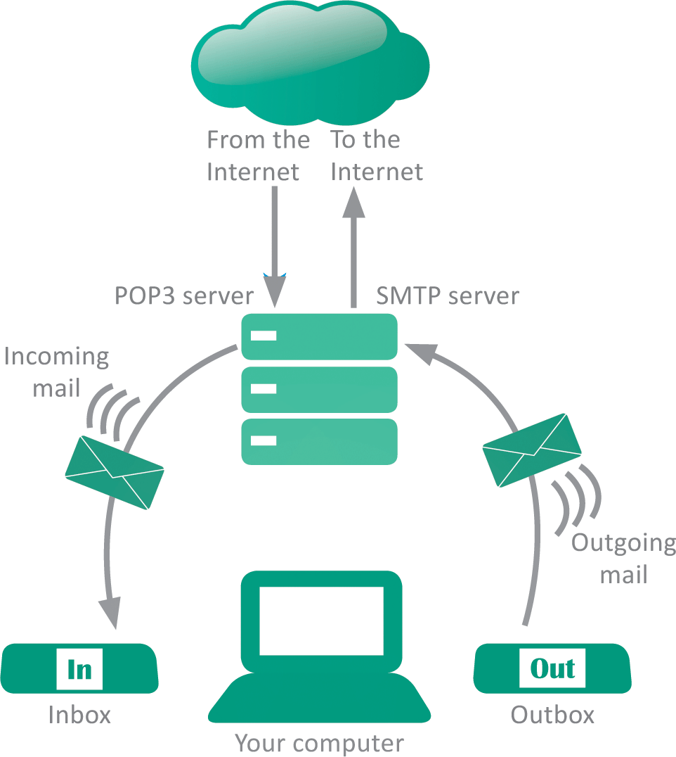
Email (7 of 8)
Keep these protocols in mind when setting up local email because the server you specify for outgoing mail might be different from the server for incoming mail

Slide 69
Email (8 of 8)
Pros and Cons of Local Email:
Offline access – you can compose and read mail offline; you only need to go online to transfer outgoing mail from your Inbox to the email server and to receive incoming messages
Control – when you use POP3 to collect your mail, your messages are transferred to your computer’s hard disk, where you can control who has access to them

Slide 70
Online Chat
Online chat services are used when you want to establish two-way communication
Instant messaging (IM) is a synchronous, real-time technology for two or more people to type messages back and forth while online
As the Internet grew, online services, such as Yahoo!, MSN, and AOL developed IM systems
Today, IM is popular for customer service at ecommerce sites

Slide 71
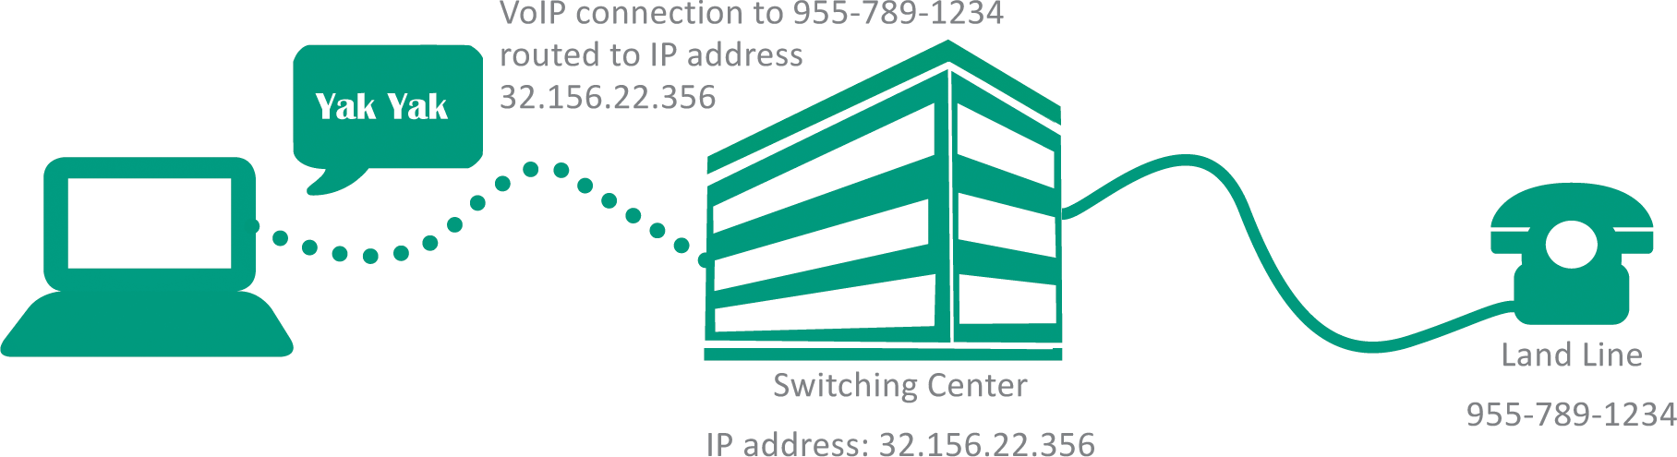
Voice and Video over IP
VoIP (Voice over Internet Protocol) is a technology that uses a broadband Internet connection instead of PSTN land lines to place voice and video calls
Skype, Google Talk, and Snapchat are examples of VoIP
VoIPs work when software converts voice communications and video images into data packets using digitized techniques similar to those presented in Unit 1

Slide 72
Section E: Social Media Values
Identity
Reputation
Privacy

Slide 73
Section E: Objectives (1 of 3)
List the elements that constitute an online identity
Describe four ways in which sockpuppets are used for purposes of deception
List three situations in which the use of an online pseudonym is justified if allowed by the social media service
Explain why using a generic profile image should be avoided

Slide 74
Section E: Objectives (2 of 3)
Differentiate between an online identity and an online reputation
List five factors that can ruin an online reputation
List four techniques for dealing with cyberbullies
State the difference between an impersonator and a doppelganger

Slide 75
Section E: Objectives (3 of 3)
List at least five reputation management practices
Explain how an online presence can become a threat to an individual’s privacy
Define each of the six types of social media data
List four potential problems with third-party social media apps

Slide 76
Identity (1 of 4)
An online identity consists of far more than a photo and a brief autobiographical sketch; the elements that constitute a social media identity include a biographical profile, the set of people who form connections, and the information supplied as posts
By some estimates, nearly 40% of all online identities are fake
False identities are used for nefarious purposes by cyberbullies, criminals, and stalkers

Slide 77

Identity (2 of 4)
The use of sockpuppets—any online identity created and used for purposes of deception—is widespread
Sockpuppet: A false identity used for purposes of deception such as:
To circumvent a suspension or ban from an online group
For surreptitious self-promotion
For criminal identity theft
To stuff online ballot boxes

Slide 78
Identity (3 of 4)
Most social media sites provide a generic profile image for users who do not upload a personal photo
Users who retain the generic image tend to be newcomers or spammers
Most social media profiles include a short, publicly viewable tagline
Detailed biographical information is generally viewable only by designated connections, depending on the user’s privacy settings

Slide 79
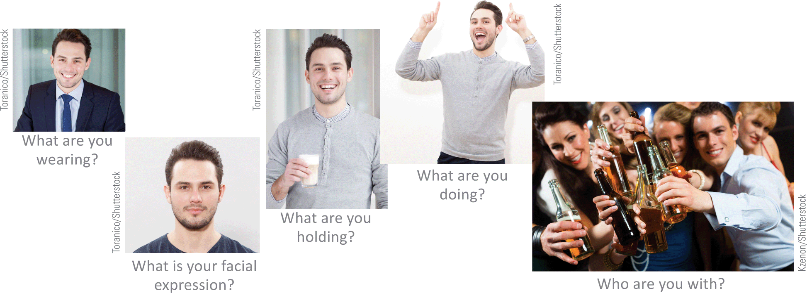
Identity (4 of 4)
Some things to consider when selecting a profile picture:

Slide 80
Reputation (1 of 9)
An online reputation is the impression that is generated by an online persona
Many factors can have a negative effect on an individual’s online reputation
Mistakes – you may inadvertently post messages, comments, or photos that could be misinterpreted; these can affect public opinion of you
Defamation – communicating false statements that damage the reputation of another individual is referred to as defamation

Slide 81
Reputation (2 of 9)
Impersonation – deliberately using the name or avatar of another person without his or her consent and with the intent to harm, defraud, or intimidate is called impersonation
Doppelgangers – Online doppelgangers are two or more online personas with the same name or username; the personas of doppelgangers are sometimes mistaken for each other, and their reputations may become intertwined

Slide 82
Reputation (3 of 9)
User Profile
Profiles may explicitly state a reputation, such as “avid skier” or “award-winning author.”
Media Presence
Elements of an online reputation are derived from multiple sources, so it includes social media accounts, blogs, and Web sites.
Contacts
People tend to interact with those who share their interests. An individual’s contacts and group associations contribute to the way that individual is regarded by others.
Popularity
The popularity of blogs and Web sites as measured by Alexa and other rating services indicate a person’s relevancy.

Slide 83
Reputation (4 of 9)
Images
Whether posted by you or by others, images provide clues about a person’s age, ethnicity, personality, and lifestyle. Viewers form opinions based on those images.
Comments
The comments that individuals append to other peoples’ posts, tweets, and blogs contribute to building a reputation within the group of participants.
Google Results
When someone uses Google to search for an individual, the first page of search results forms an impression that may be perceived as the individual’s reputation.

Slide 84
Reputation (5 of 9)
Expertise
Many reputations are built on knowledge and expertise that are displayed in various online forums, social media, and offline sources.
Posts Words
pictures, and videos that individuals post about themselves are evaluated by others to form an impression that becomes an online reputation.

Slide 85
Reputation (6 of 9)
Cultivate your roster of friends. Don’t be tempted to bump up your numbers by accepting invitations from random avatars operated by spammers.
Search for your name and make note of any results that might damage your reputation.
Use Google Alerts to keep informed of information that is posted about you.
Adjust settings within your social media accounts so that you are notified when you are tagged in photos and videos.
Don’t let your online identities languish. Add posts regularly.

Slide 86
Reputation (7 of 9)
Check all your social media sites periodically to make sure they have not been compromised by identity thieves.
Maintain a consistent user name and identity across sites-especially those that are open to the public.
Remove posts, comments, photos, and blog entries that don’t portray your desired online image.
Push enough positive information to the top of your Google search results to obscure any negative content that relates to you.
Separate your professional sites from your personal sites and keep posts appropriate to each.

Slide 87
Reputation (8 of 9)
Consider buying domain names that contain your real name.
Establish accounts on all the popular social media sites so that others cannot impersonate you there.
Maintain civil discourse. Democracies promote free speech, but there are legal and cultural limits. You must be alert, within all of your networking circles, for the norms regarding speech that is acceptable and speech that is not.

Slide 88
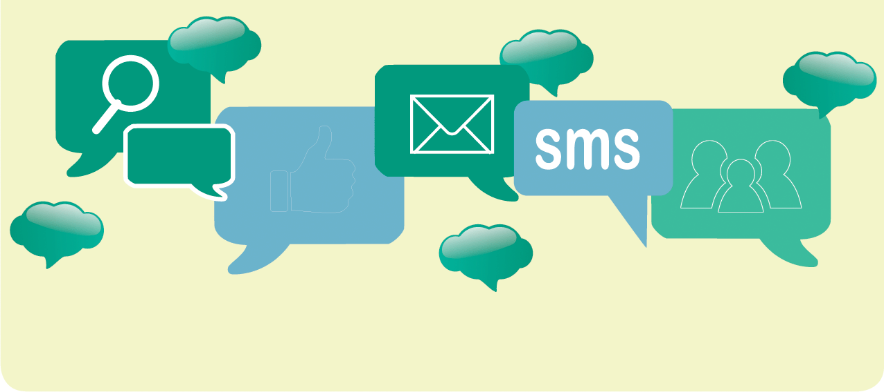
Reputation (9 of 9)

Slide 89
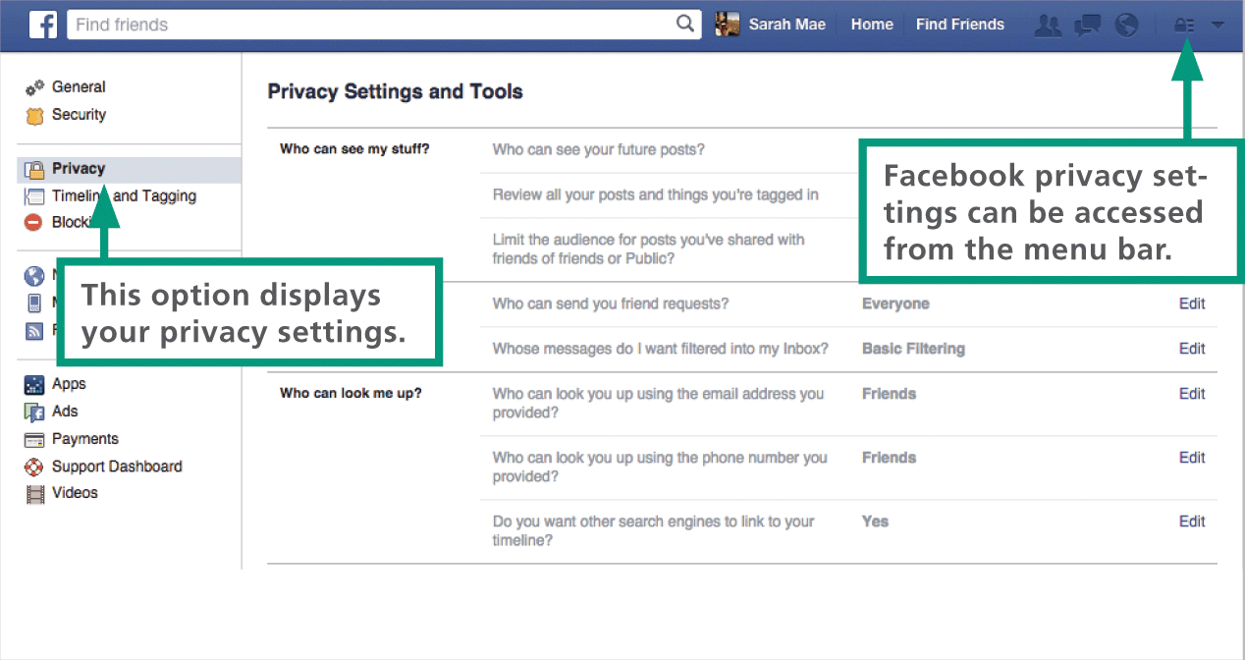
Privacy (1 of 6)
Privacy is “the right to be left alone”
Individuals can control their own personally identifiable information (PII) to limit when they can be identified, tracked, or contacted
Most social media services have a written privacy policy that states how PII data is handled and how long it is stored

Slide 90
Privacy (2 of 6)
Key steps in maintaining online privacy include awareness of the different types of data collected by social media services and the level of privacy appropriate for each type
服务数据 | 您在注册使用社交媒体服务时提供给该服务的数据。此类数据可能包括您的法定姓名、年龄和信用卡号。
公开数据 | 您在自己的网页上发布的信息。此类信息可以包括博客文章、照片、消息和评论。（发布后可修改）
委托数据 | 您在其他人的网页上发布的信息。此信息包含与披露数据相同的项目，但一旦发布数据，您就无法控制这些数据。（改不了了）
附带数据 | 其他人发布的有关您的信息。与委托数据一样，您无法控制它。
行为数据 | 社交媒体服务根据您的习惯、网站使用情况、帖子内容和连接收集的有关您的数据
派生数据 | 从所有其他数据派生的有关您的数据。例如，如果你的很多朋友自我认同为同性恋，那么你的衍生数据也可能将你描述为同性恋。

Slide 91
Privacy (3 of 6)
Data “gone rogue” escapes its appropriate privacy setting and somehow goes public
The most common causes of rogue data include:
A user changes his or her global privacy setting to Public
A user designates an item as public when it is posted
Changes in the social media service’s privacy policy result in previously private information becoming public
A user ignores changes in the social media service’s privacy policy
Posted information is reposted publicly
Third-party social networking apps redistribute information collected as the user works with an app

Slide 92
Privacy (4 of 6)
Hundreds of third-party social media apps are available and they all collect information from social media profiles, including contact lists
The following aspects of third-party apps may affect your privacy:
Collected data might not be transmitted over secure channels
An excessive amount of personal data could be collected
Data about your contacts might be collected

Slide 93
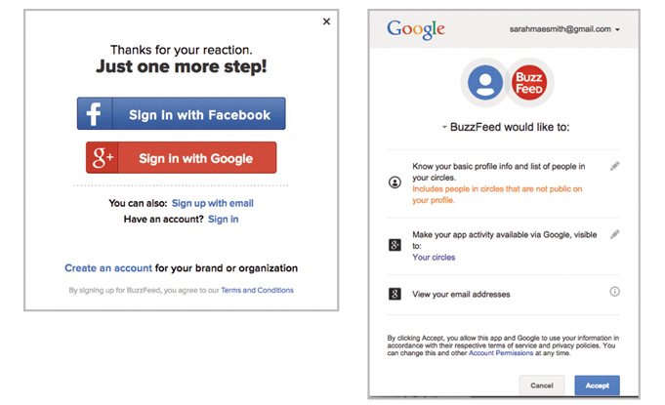
Privacy (5 of 6)
Before installing a third-party app, be aware of the information that it will collect from your social media accounts.

Slide 94
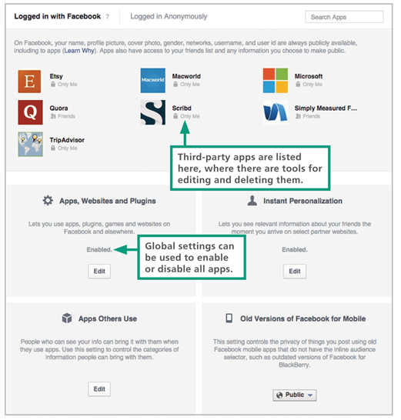
Privacy (6 of 6)
Access Facebook’s third-party app settings from the Settings menu, which is a pull-down list located in the upper-right corner of the Facebook toolbar.

